Slide 1

Support Analysis

Slide 2
RTL (right to left) conversion support
RTL (right to left) text
יישומונים 80 ועוד
دعم الزاوي على أساس
Bidirectional text
עיצובים מובנים bidirectional אישית
Hebrew text with Left to Right
עיצובים מובנים וניתנים להתאמה אישית
הדגמה זמינה ב
http://js.syncfusion.com/demos/web/

Slide 3
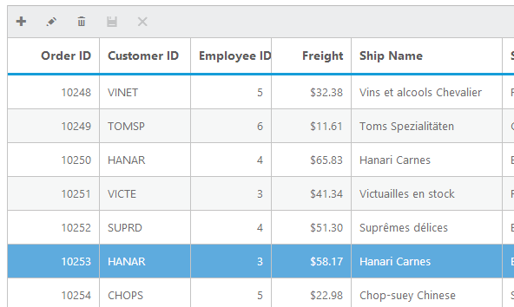
Grid
v

Slide 4
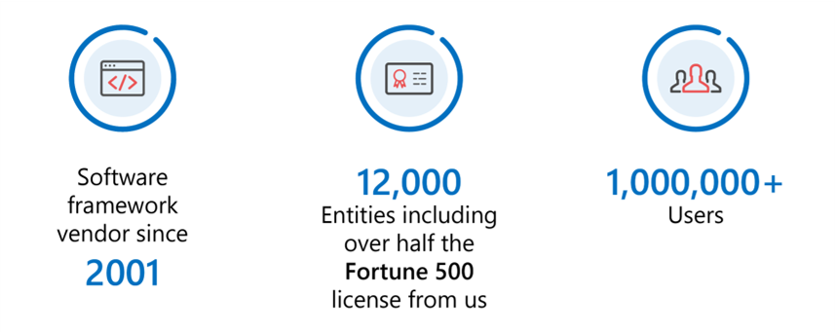

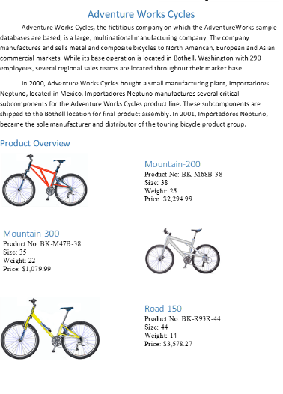

Chart
20 chart types

Slide 5
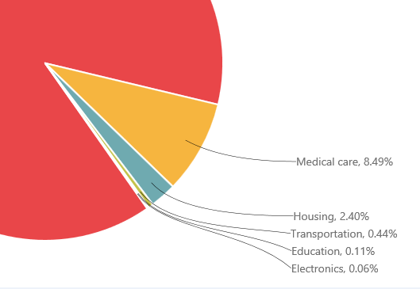




Chart smart labels
i

Slide 6

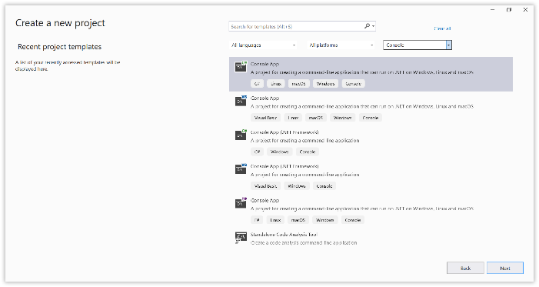
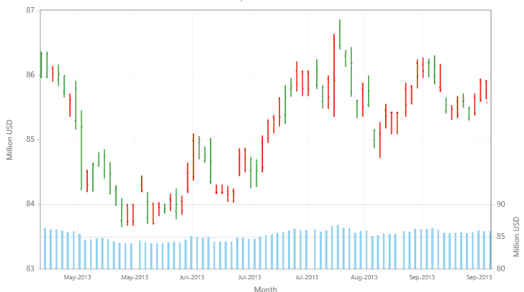





Chart Rows

Slide 7
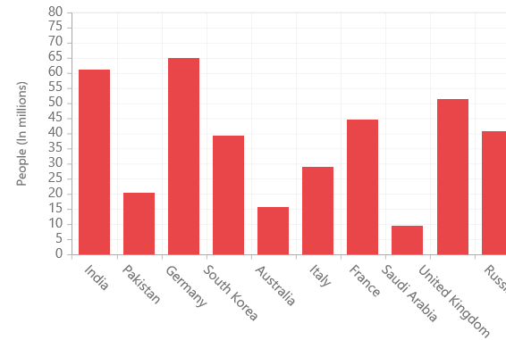
Chart Rotate labels

Slide 8
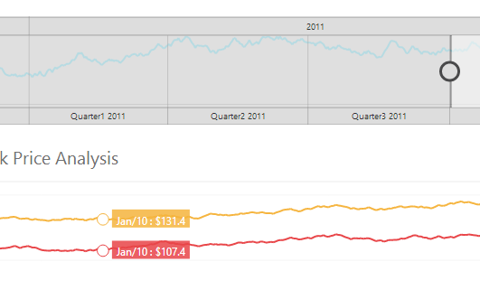
Range Navigator

Slide 9
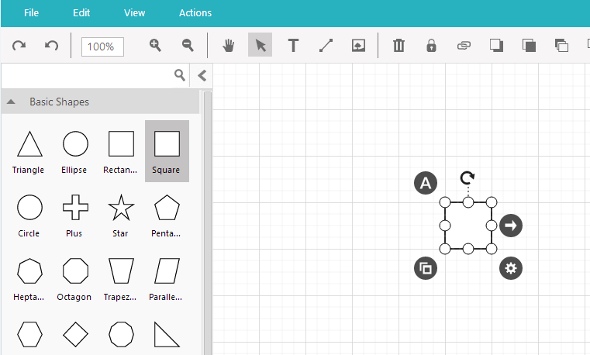
Diagram

Slide 10
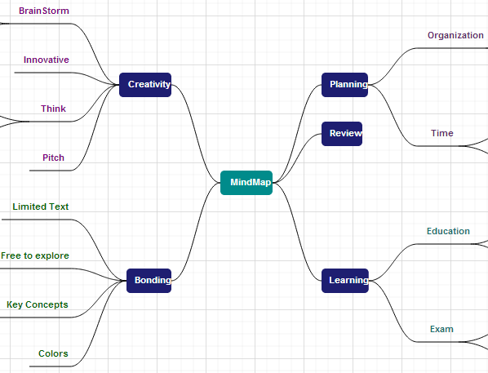
Diagram Mindmap

Slide 11
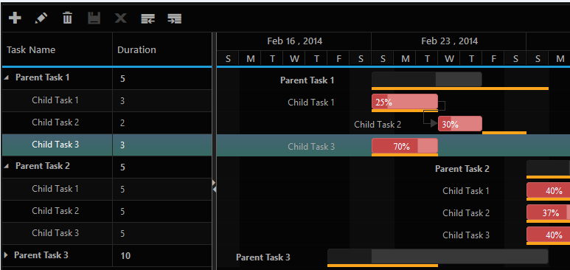
Gantt

Slide 12
Range Navigator

Slide 13
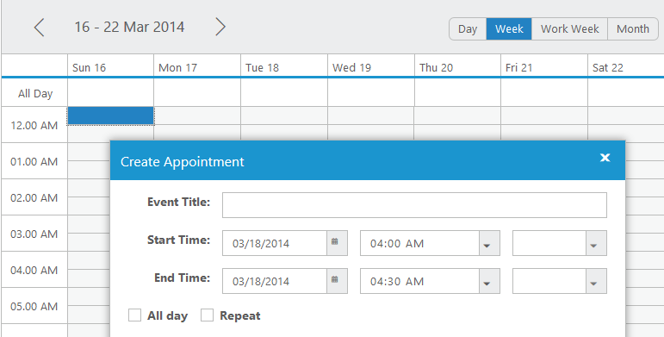
Schedule

Slide 14
Bullet Graph

Slide 15
Bullet Graph

Slide 16
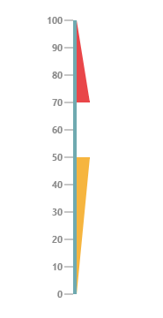
Linear Gauge

Slide 17
Schedule

Slide 18

Linear Gauge

Slide 19
Maps

Slide 20
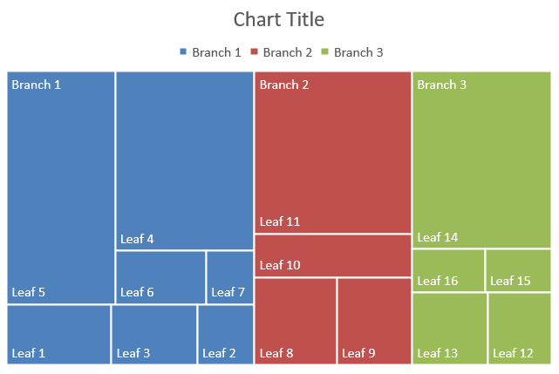
Treemap

Slide 21
Bullet Graph

Slide 22
Bullet Graph

Slide 23
Maps

Slide 24
Treemap

Slide 25
Bullet Graph

Slide 26
Bullet Graph

Slide 27
Maps

Slide 28
Treemap

Slide 29
Bullet Graph

Slide 30
Bullet Graph

Slide 31
Maps

Slide 32
Treemap

Slide 33
Bullet Graph

Slide 34
Bullet Graph

Slide 35
Maps

Slide 36
Treemap

Slide 37

Menu

Slide 38
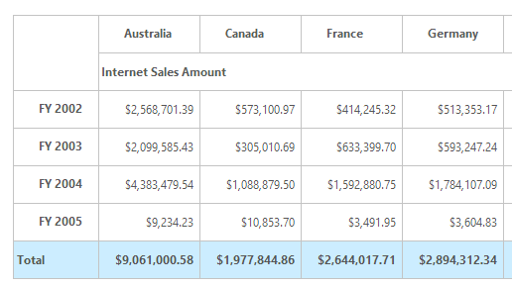
Olap Grid

Slide 39
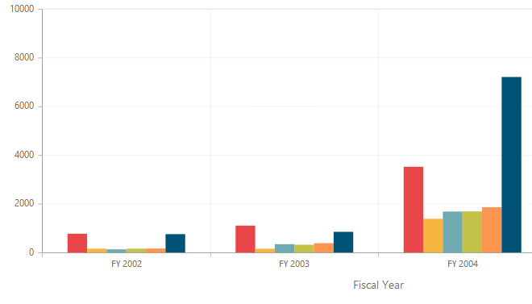
Olap Chart

Slide 40
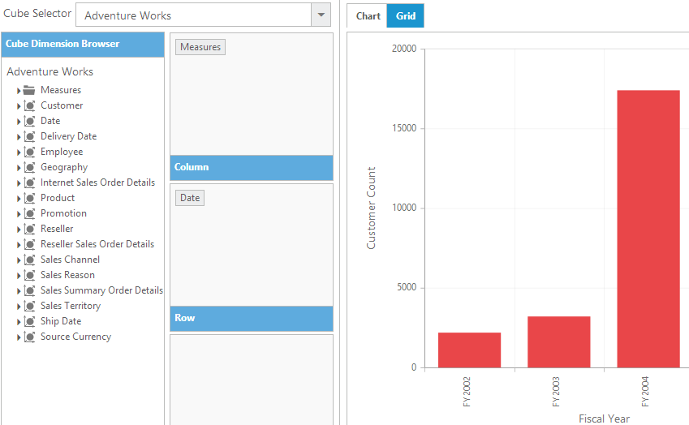

Olap Client

Slide 41
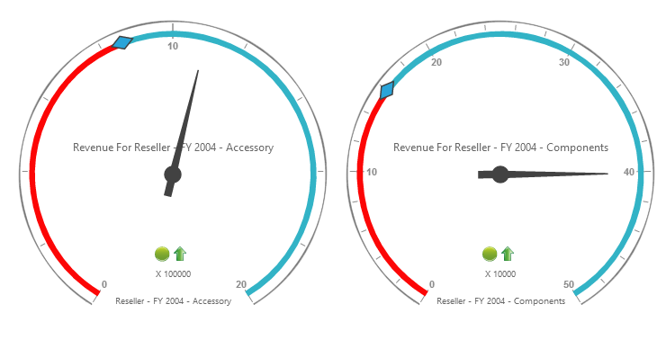
Olap Gauge

Slide 42
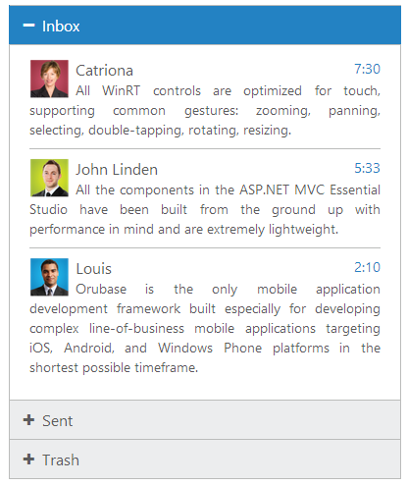
Accordion

Slide 43

Progress Bar

Slide 44

Rating

Slide 45
Bullet Graph

Slide 46
Bullet Graph

Slide 47
Maps

Slide 48
Treemap

Slide 49
Bullet Graph

Slide 50
Bullet Graph

Slide 51
Maps

Slide 52
Treemap

Slide 53
Bullet Graph

Slide 54
Bullet Graph

Slide 55
Maps

Slide 56
Treemap

Slide 57
Bullet Graph

Slide 58
Bullet Graph

Slide 59
Maps

Slide 60
Treemap

Slide 61
Bullet Graph

Slide 62
Bullet Graph

Slide 63
Maps

Slide 64
Treemap

Slide 65
Bullet Graph

Slide 66
Bullet Graph

Slide 67
Maps

Slide 68
Treemap

Slide 69
Bullet Graph

Slide 70
Bullet Graph

Slide 71
Maps

Slide 72
Treemap

Slide 73
Bullet Graph

Slide 74
Bullet Graph

Slide 75
Bullet Graph

Slide 76
Maps

Slide 77
Treemap

Slide 78
Bullet Graph

Slide 79
Date Time Picker

Slide 80
Bullet Graph

Slide 81
Maps

Slide 82
Treemap

Slide 83
Bullet Graph

Slide 84
Date Time Picker

Slide 85
Bullet Graph

Slide 86
Maps

Slide 87
Treemap

Slide 88
Bullet Graph

Slide 89
Date Time Picker

Slide 90
Date Time Picker

Slide 91
Bullet Graph

Slide 92
Maps

Slide 93
Treemap

Slide 94
Bullet Graph

Slide 95
Date Time Picker

Slide 96
Date Time Picker

Slide 97
Bullet Graph

Slide 98
Maps

Slide 99
Treemap

Slide 100
Bullet Graph

Slide 101
Maps

Slide 102
Treemap

Slide 103
Bullet Graph

Slide 104
Date Time Picker

Slide 105
Date Time Picker

Slide 106
Maps

Slide 107
Treemap

Slide 108
Bullet Graph

Slide 109
Date Time Picker

Slide 110
Date Time Picker

Slide 111
Maps

Slide 112
Treemap

Slide 113
Bullet Graph

Slide 114
Date Time Picker

Slide 115
Date Time Picker

Slide 116
Maps

Slide 117
Treemap

Slide 118
Bullet Graph

Slide 119
Date Time Picker

Slide 120
Date Time Picker

Slide 121
Maps

Slide 122
Treemap

Slide 123
Bullet Graph

Slide 124
Date Time Picker

Slide 125
Date Time Picker

Slide 126
Maps

Slide 127
Treemap

Slide 128
Bullet Graph

Slide 129
Date Time Picker

Slide 130
Date Time Picker

Slide 131

Support Analysis

Slide 132
Maps

Slide 133
Treemap

Slide 134
Bullet Graph

Slide 135
Date Time Picker

Slide 136
Date Time Picker

Slide 137
Maps

Slide 138
Treemap

Slide 139
Bullet Graph

Slide 140
Date Time Picker

Slide 141
Date Time Picker

Slide 142
Maps

Slide 143
Treemap

Slide 144
Bullet Graph

Slide 145
Date Time Picker

Slide 146
Date Time Picker

Slide 147
Maps

Slide 148
Treemap

Slide 149
Bullet Graph

Slide 150
Date Time Picker

Slide 151
Date Time Picker

Slide 152
Maps

Slide 153
Treemap

Slide 154
Bullet Graph

Slide 155
Date Time Picker

Slide 156
Date Time Picker

Slide 157
Maps

Slide 158
Treemap

Slide 159
Bullet Graph

Slide 160
Date Time Picker

Slide 161
Date Time Picker

Slide 162
Maps

Slide 163
Treemap

Slide 164
Bullet Graph

Slide 165
Date Time Picker

Slide 166
Date Time Picker

Slide 167
Maps

Slide 168
Treemap

Slide 169
Bullet Graph

Slide 170
Date Time Picker

Slide 171
Date Time Picker

Slide 172
Maps

Slide 173
Treemap

Slide 174
Bullet Graph

Slide 175
Date Time Picker

Slide 176
Date Time Picker

Slide 177
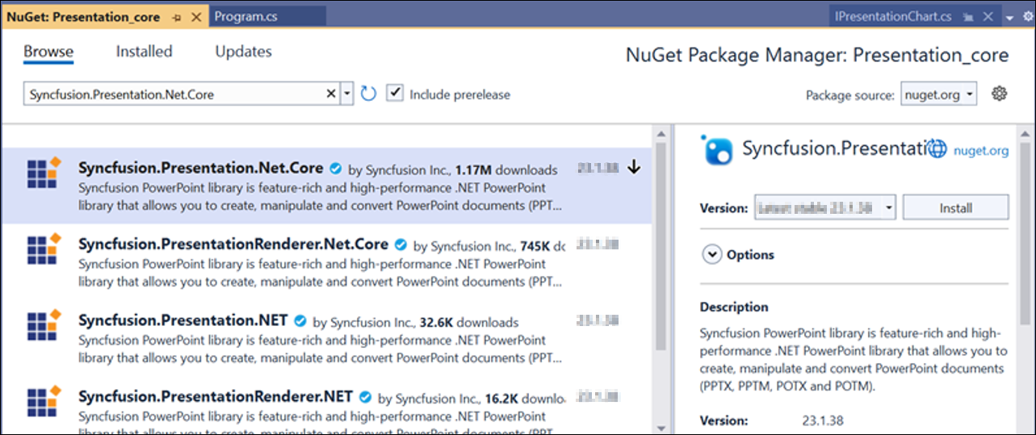
Grid
v

Slide 178
Chart
20 chart types

Slide 179
Support Analysis

Slide 180
Grid
v

Slide 181
Chart
20 chart types

Slide 182
Support Analysis

Slide 183
Grid
v

Slide 184
Chart
20 chart types

Slide 185
Chart smart labels
i

Slide 186
Support Analysis

Slide 187
Chart
20 chart types

Slide 188

Time Picker

Slide 189
Date Time Picker

Slide 190
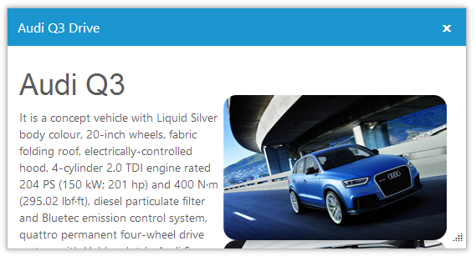
Dialog

Slide 191
Maps

Slide 192
Treemap

Slide 193
Bullet Graph

Slide 194
Date Time Picker

Slide 195
Date Time Picker

Slide 196
Maps

Slide 197
Treemap

Slide 198
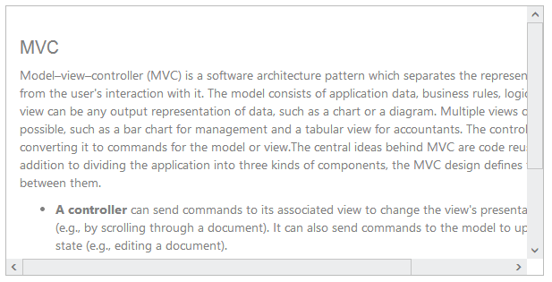
Scrollbar

Slide 199

Barcode

Slide 200
Demo
Essential JS Demo
http://js.syncfusion.com/demos/web/
Contact Us
sales@syncfusion.com

Slide 201
Support Analysis

Slide 202
Range Navigator

Slide 203
Maps

Slide 204
Treemap

Slide 205
Bullet Graph

Slide 206
Date Time Picker

Slide 207
Date Time Picker

Slide 208
Date Time Picker

Slide 209
Diagram

Slide 210
Schedule

Slide 211
Date Time Picker

Slide 212
Date Time Picker

Slide 213
Date Time Picker

Slide 214
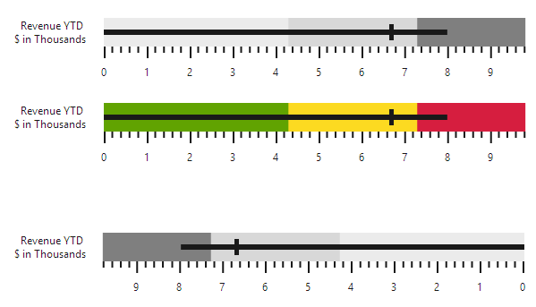
Bullet Graph

Slide 215
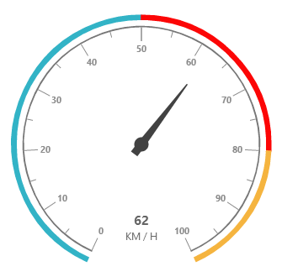
Bullet Graph

Slide 216
Linear Gauge

Slide 217
Schedule

Slide 218
Linear Gauge

Slide 219

Maps

Slide 220
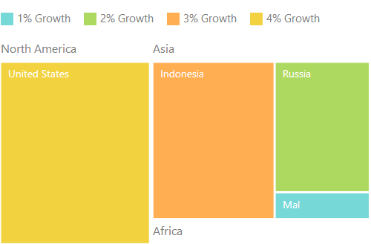
Treemap

Slide 221
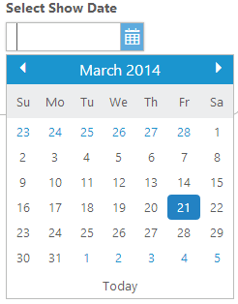
Date Picker

Slide 222
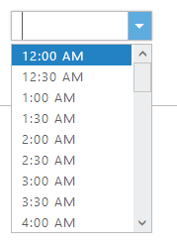
Time Picker

Slide 223
Linear Gauge

Slide 224
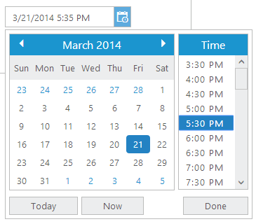
Time Picker

Slide 225
Date Time Picker

Slide 226
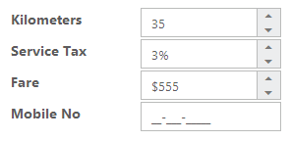
Text Boxes

Slide 227
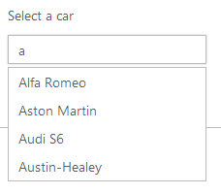
Auto Complete

Slide 228
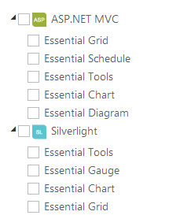
Tree View

Slide 229
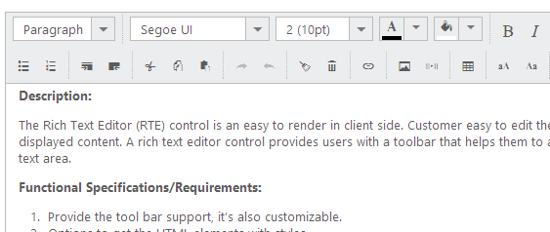
Rich Text Box

Slide 230

Rotator

Slide 231

Tabs

Slide 232
Menu

Slide 233
Olap Grid

Slide 234
Olap Chart

Slide 235
Olap Client

Slide 236
Olap Gauge

Slide 237
Accordion

Slide 238
Progress Bar

Slide 239
Rating

Slide 240
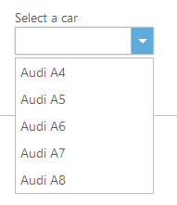
Drop DownList

Slide 241
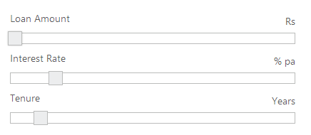
Slider

Slide 242
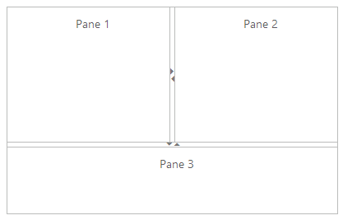
Splitter

Slide 243
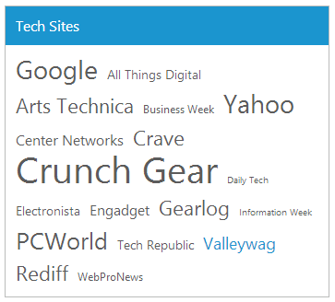
Tag Cloud

Slide 244
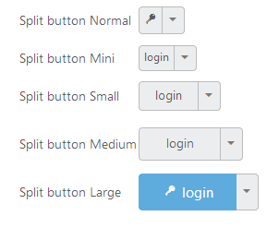
Button

Slide 245
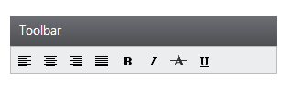
Toolbar

Slide 246


Waiting Popup

Slide 247
Dialog

Slide 248
Scrollbar

Slide 249
Barcode

Slide 250
Demo
Essential JS Demo
http://js.syncfusion.com/demos/web/
Contact Us
sales@syncfusion.com

Slide 251
Support Analysis

Slide 252
RTL (right to left) conversion support
RTL (right to left) text
יישומונים 80 ועוד
دعم الزاوي على أساس
Bidirectional text
עיצובים מובנים bidirectional אישית
Hebrew text with Left to Right
עיצובים מובנים וניתנים להתאמה אישית
הדגמה זמינה ב
http://js.syncfusion.com/demos/web/

Slide 253
Grid
v

Slide 254
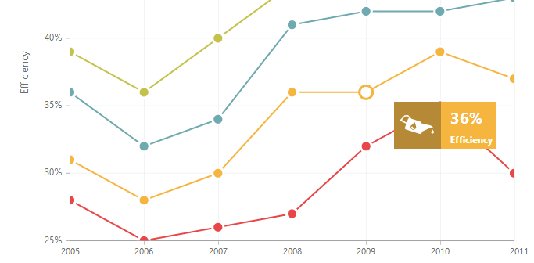
Chart
20 chart types

Slide 255
Chart smart labels
i

Slide 256
Chart Rows

Slide 257
Chart Rotate labels

Slide 258
Range Navigator

Slide 259
Diagram

Slide 260
Diagram Mindmap

Slide 261
Gantt

Slide 262
Range Navigator

Slide 263
Schedule

Slide 264
Bullet Graph

Slide 265
Bullet Graph

Slide 266
Linear Gauge

Slide 267
Schedule

Slide 268
Linear Gauge

Slide 269
Maps

Slide 270
Treemap

Slide 271
Date Picker

Slide 272
Time Picker

Slide 273
Linear Gauge

Slide 274
Time Picker

Slide 275
Date Time Picker

Slide 276
Text Boxes

Slide 277
Auto Complete

Slide 278
Tree View

Slide 279
Rich Text Box

Slide 280
Rotator

Slide 281
Tabs

Slide 282
Menu

Slide 283
Olap Grid

Slide 284
Olap Chart

Slide 285
Olap Client

Slide 286
Olap Gauge

Slide 287
Accordion

Slide 288
Progress Bar

Slide 289
Rating

Slide 290
Drop DownList

Slide 291
Slider

Slide 292
Splitter

Slide 293
Tag Cloud

Slide 294
Button

Slide 295
Toolbar

Slide 296
Waiting Popup

Slide 297
Dialog

Slide 298
Scrollbar

Slide 299
Barcode

Slide 300
Demo
Essential JS Demo
http://js.syncfusion.com/demos/web/
Contact Us
sales@syncfusion.com

Slide 301
Support Analysis

Slide 302
RTL (right to left) conversion support
RTL (right to left) text
יישומונים 80 ועוד
دعم الزاوي على أساس
Bidirectional text
עיצובים מובנים bidirectional אישית
Hebrew text with Left to Right
עיצובים מובנים וניתנים להתאמה אישית
הדגמה זמינה ב
http://js.syncfusion.com/demos/web/

Slide 303
Grid
v

Slide 304
Chart
20 chart types

Slide 305
Chart smart labels
i

Slide 306
Chart Rows

Slide 307
Chart Rotate labels

Slide 308
Range Navigator

Slide 309
Diagram

Slide 310
Diagram Mindmap

Slide 311
Gantt

Slide 312
Range Navigator

Slide 313
Schedule

Slide 314
Bullet Graph

Slide 315
Bullet Graph

Slide 316
Linear Gauge

Slide 317
Schedule

Slide 318
Linear Gauge

Slide 319
Maps

Slide 320
Treemap

Slide 321
Date Picker

Slide 322
Time Picker

Slide 323
Linear Gauge

Slide 324
Time Picker

Slide 325
Date Time Picker

Slide 326
Text Boxes

Slide 327
Auto Complete

Slide 328
Tree View

Slide 329
Rich Text Box

Slide 330
Rotator

Slide 331
Tabs

Slide 332
Menu

Slide 333
Olap Grid

Slide 334
Olap Chart

Slide 335
Olap Client

Slide 336
Olap Gauge

Slide 337
Accordion

Slide 338
Progress Bar

Slide 339
Rating

Slide 340
Drop DownList

Slide 341
Slider

Slide 342
Splitter

Slide 343
Tag Cloud

Slide 344
Button

Slide 345
Toolbar

Slide 346
Waiting Popup

Slide 347
Dialog

Slide 348
Scrollbar

Slide 349
Barcode

Slide 350
Demo
Essential JS Demo
http://js.syncfusion.com/demos/web/
Contact Us
sales@syncfusion.com

Slide 351
Support Analysis

Slide 352
RTL (right to left) conversion support
RTL (right to left) text
יישומונים 80 ועוד
دعم الزاوي على أساس
Bidirectional text
עיצובים מובנים bidirectional אישית
Hebrew text with Left to Right
עיצובים מובנים וניתנים להתאמה אישית
הדגמה זמינה ב
http://js.syncfusion.com/demos/web/

Slide 353
Grid
v

Slide 354
Chart
20 chart types

Slide 355
Chart smart labels
i

Slide 356
Chart Rows

Slide 357
Chart Rotate labels

Slide 358
Range Navigator

Slide 359
Diagram

Slide 360
Diagram Mindmap

Slide 361
Gantt

Slide 362
Range Navigator

Slide 363
Schedule

Slide 364
Bullet Graph

Slide 365
Bullet Graph

Slide 366
Linear Gauge

Slide 367
Schedule

Slide 368
Linear Gauge

Slide 369
Maps

Slide 370
Treemap

Slide 371
Date Picker

Slide 372
Time Picker

Slide 373
Linear Gauge

Slide 374
Time Picker

Slide 375
Date Time Picker

Slide 376
Text Boxes

Slide 377
Auto Complete

Slide 378
Tree View

Slide 379
Rich Text Box

Slide 380
Rotator

Slide 381
Tabs

Slide 382
Menu

Slide 383
Olap Grid

Slide 384
Olap Chart

Slide 385
Olap Client

Slide 386
Olap Gauge

Slide 387
Accordion

Slide 388
Progress Bar

Slide 389
Rating

Slide 390
Drop DownList

Slide 391
Slider

Slide 392
Splitter

Slide 393
Tag Cloud

Slide 394
Button

Slide 395
Toolbar

Slide 396
Waiting Popup

Slide 397
Dialog

Slide 398
Scrollbar

Slide 399
Barcode

Slide 400
Demo
Essential JS Demo
http://js.syncfusion.com/demos/web/
Contact Us
sales@syncfusion.com

Slide 401
Support Analysis

Slide 402
RTL (right to left) conversion support
RTL (right to left) text
יישומונים 80 ועוד
دعم الزاوي على أساس
Bidirectional text
עיצובים מובנים bidirectional אישית
Hebrew text with Left to Right
עיצובים מובנים וניתנים להתאמה אישית
הדגמה זמינה ב
http://js.syncfusion.com/demos/web/

Slide 403
Grid
v

Slide 404
Chart
20 chart types

Slide 405
Chart smart labels
i

Slide 406
Chart Rows

Slide 407
Chart Rotate labels

Slide 408
Range Navigator

Slide 409
Diagram

Slide 410
Diagram Mindmap

Slide 411
Gantt

Slide 412
Range Navigator

Slide 413
Schedule

Slide 414
Bullet Graph

Slide 415
Bullet Graph

Slide 416
Linear Gauge

Slide 417
Schedule

Slide 418
Linear Gauge

Slide 419
Maps

Slide 420
Treemap

Slide 421
Date Picker

Slide 422
Time Picker

Slide 423
Linear Gauge

Slide 424
Time Picker

Slide 425
Date Time Picker

Slide 426
Text Boxes

Slide 427
Auto Complete

Slide 428
Tree View

Slide 429
Rich Text Box

Slide 430
Rotator

Slide 431
Tabs

Slide 432
Menu

Slide 433
Olap Grid

Slide 434
Olap Chart

Slide 435
Olap Client

Slide 436
Olap Gauge

Slide 437
Accordion

Slide 438
Progress Bar

Slide 439
Rating

Slide 440
Drop DownList

Slide 441
Slider

Slide 442
Splitter

Slide 443
Tag Cloud

Slide 444
Button

Slide 445
Toolbar

Slide 446
Waiting Popup

Slide 447
Dialog

Slide 448
Scrollbar

Slide 449
Barcode

Slide 450
Demo
Essential JS Demo
http://js.syncfusion.com/demos/web/
Contact Us
sales@syncfusion.com

Slide 451
Support Analysis

Slide 452
RTL (right to left) conversion support
RTL (right to left) text
יישומונים 80 ועוד
دعم الزاوي على أساس
Bidirectional text
עיצובים מובנים bidirectional אישית
Hebrew text with Left to Right
עיצובים מובנים וניתנים להתאמה אישית
הדגמה זמינה ב
http://js.syncfusion.com/demos/web/

Slide 453
Grid
v

Slide 454
Chart
20 chart types

Slide 455
Chart smart labels
i

Slide 456
Chart Rows

Slide 457
Chart Rotate labels

Slide 458
Range Navigator

Slide 459
Diagram

Slide 460
Diagram Mindmap

Slide 461
Gantt

Slide 462
Range Navigator

Slide 463
Schedule

Slide 464
Bullet Graph

Slide 465
Bullet Graph

Slide 466
Linear Gauge

Slide 467
Schedule

Slide 468
Linear Gauge

Slide 469
Maps

Slide 470
Treemap

Slide 471
Date Picker

Slide 472
Time Picker

Slide 473
Linear Gauge

Slide 474
Time Picker

Slide 475
Date Time Picker

Slide 476
Text Boxes

Slide 477
Auto Complete

Slide 478
Tree View

Slide 479
Rich Text Box

Slide 480
Rotator

Slide 481
Tabs

Slide 482
Menu

Slide 483
Olap Grid

Slide 484
Olap Chart

Slide 485
Olap Client

Slide 486
Olap Gauge

Slide 487
Accordion

Slide 488
Progress Bar

Slide 489
Rating

Slide 490
Drop DownList

Slide 491
Slider

Slide 492
Splitter

Slide 493
Tag Cloud

Slide 494
Button

Slide 495
Toolbar

Slide 496
Waiting Popup

Slide 497
Dialog

Slide 498
Scrollbar

Slide 499
Barcode

Slide 500
Demo
Essential JS Demo
http://js.syncfusion.com/demos/web/
Contact Us
sales@syncfusion.com

